Slide 1
Pattern Recognition
Chapter2 Distance based Pattern Recognition

Slide 2
Outline
Distance measures for pattern classification
Minimum euclidean distance(MED) classifier
Prototype selection
Examples

Slide 3
Distance measures for PR
Distance measures for PR
Minimum euclidean distance (MED) classifier
Prototype selection
Examples
Intuitively, two patterns that are sufficiently similar should be assigned to the same class.
But what does “similar” mean?
  How similar are these patterns quantitatively?
  How similar are they to a particular class quantitatively?
Since we represent patterns quantitatively as vectors in a feature space, it is often possible to:
  Use some measure of similarity between two patterns to quantify how similar their attributes are
  Use some measure of similarity between a pattern and a prototype to quantify how similar it is with a class
Notes:
We know a lot of distance measures between vectors! While, the mostly used is euclidean distance

Slide 4
MED classifier
Distance measures for PR
Minimum euclidean distance (MED) classifier
Prototype selection
Examples
Definition:
x∈ c_{k} iff d_{E}(x, z_{k})< d_{E}(x, z_{I}) (1)
For all I≠k, where
d_{E}(x, z_{k})=[ (x - z_{k})^{T}(x - z_{k})]^{1/2} (2)
c_{k} : the k^{th} class
z_{k} : the prototype (feature vector) of c_{k} .
Meaning: x belongs to class k if and only if the Euclidean distance between x and the prototype of c_{k} is less than the distance between x and all other class prototypes.

Slide 5
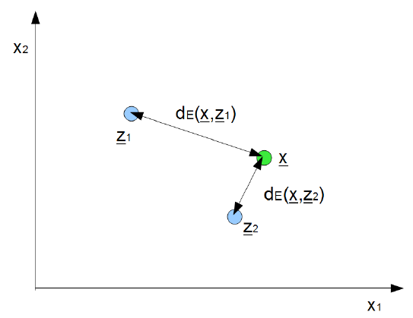
MED classifier: visualization
Distance measures for PR
Minimum euclidean distance (MED) classifier
Prototype selection
Examples

Slide 6



MED: discriminant function
Distance measures for PR
Minimum euclidean distance (MED) classifier
Prototype selection
Examples
Simplifying the decision criteria d_{E}(x, z_{k})< d_{E}(x, z_{I}) gives us:
This gives us the discrimination/decision function:
Therefore, we get a simpler MED classification for given x:

Slide 7
MEDC: decision boundary
Distance measures for PR
Minimum euclidean distance (MED) classifier
Prototype selection
Examples
Formed by features equidistant to two classes:
g_{k-l}(x)=g_{k}(x)-g_{l}(x)=0
For MED classifier, the decision boundary becomes:
g_{k-l}(x)=(z_{k} - z_{l})^{T}x+1/2(z_{l}^{T}z_{l} - z_{k}^{T}z_{k})=0
g(x)=w^{T}x+w₀=0

Slide 8
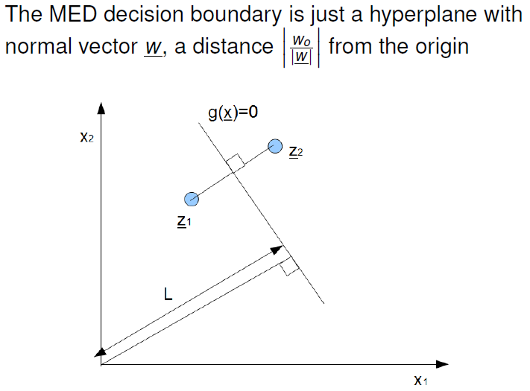
Decision boundary visualization
Distance measures for PR
Minimum euclidean distance (MED) classifier
Prototype selection
Examples
当有3个不同类别时，决策面是什么样子的？
Notes:
当有3个不同类别时，利用两两决策面划分进行决策时，可能会出现一个区域无法判别类别！然而使用原始的距离判别函数（每次比较多个不同距离）不会出现这个问题。

Slide 9
Prototype selection
Distance measures for PR
Minimum euclidean distance (MED) classifier
Prototype selection
Examples
So far, we’ve assumed that we have a specific prototype z_{j} for each class.
But how do we select such a class prototype?
Choice of class prototype will affect the way the classifier works.
Let us study the classification problem where:
  We have a set of samples with known classes c_{k}
  We need to determine a class prototype based on these labeled samples.

Slide 10
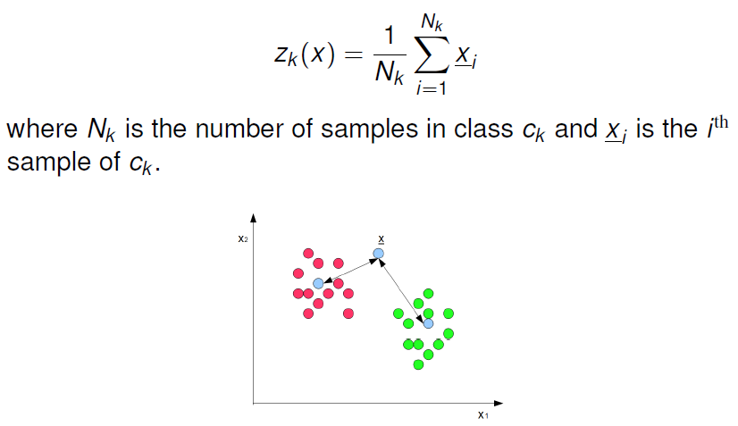
Sample mean
Distance measures for PR
Minimum euclidean distance (MED) classifier
Prototype selection
Examples

Slide 11
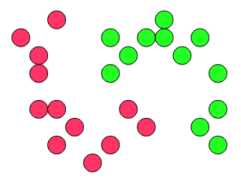
Sample mean
Distance measures for PR
Minimum euclidean distance (MED) classifier
Prototype selection
Examples
Advantages:
  + Less sensitive to noise and outliers
Disadvantages:
  -Poor at handling long, thin, tendril-like clusters

Slide 12
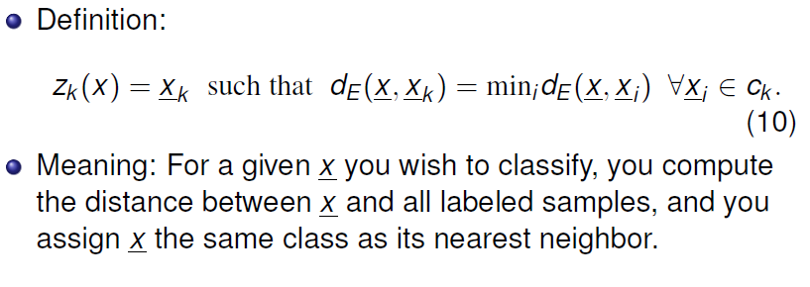
The nearest neighbor(NN)
Distance measures for PR
Minimum euclidean distance (MED) classifier
Prototype selection
Examples

Slide 13
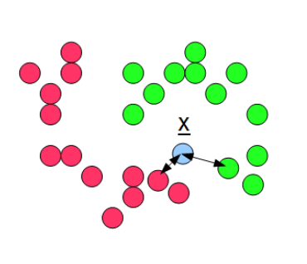
The nearest neighbor(NN)
Distance measures for PR
Minimum euclidean distance (MED) classifier
Prototype selection
Examples

Slide 14
The nearest neighbor(NN)
Distance measures for PR
Minimum euclidean distance (MED) classifier
Prototype selection
Examples
Advantages:
  +Better at handling long, thin, tendrill-like clusters.
Disadvantages:
  - More sensitive to noise and outliers
  -Computationally complex (need to re-compute all prototypes for each new point)

Slide 15
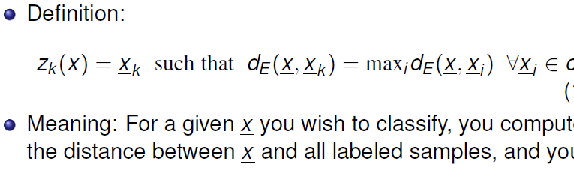
Furthest Neighbor(FN)
Distance measures for PR
Minimum euclidean distance (MED) classifier
Prototype selection
Examples

Slide 16
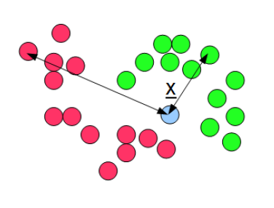
Furthest neighbor(FN)
Distance measures for PR
Minimum euclidean distance (MED) classifier
Prototype selection
Examples

Slide 17
Furthest neighbor(FN)
Distance measures for PR
Minimum euclidean distance (MED) classifier
Prototype selection
Examples
Advantages:
  +More tight, compact clusters
Disadvantages:
  -More sensitive to noise and outliers
  -Computationally complex(need to re-compute all prototypes for each new point)

Slide 18
K-nearest neighbors(KNN)
Distance measures for PR
Minimum euclidean distance (MED) classifier
Prototype selection
Examples
Idea:
  Nearest neighbor is sensitive to noise, but handles long, tendrill-like clusters well
  Sample mean is less sensitive to noise, but poorly handles long, tendril-like clusters
  What if we combine the two ideas？
Definition:
  for a given x you wish to classify, you compute the distance between x and all labeled samples, and you define the prototype in each cluster as the sample-mean of the K samples within that cluster that is nearest to x.

Slide 19
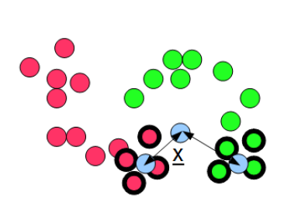
KNN
Distance measures for PR
Minimum euclidean distance (MED) classifier
Prototype selection
Examples

Slide 20
KNN
Distance measures for PR
Minimum euclidean distance (MED) classifier
Prototype selection
Examples
Advantages:
  +Less sensitive to noise and outliers
  +Better at handling long, thin, tendril-like clusters
Disadvantages:
  -Computationally complex(need to re-compute all prototypes for each new point)

Slide 21
Examples
Distance measures for PR
Minimum euclidean distance (MED) classifier
Prototype selection
Examples
Suppose we are given the following labeled samples:
  Class1: x₁=[2,1]^{T}, x₂ =[3,2]^{T}, x₃=[2,7]^{T}, x₄=[5,2]^{T}
  Class2: x₁=[3,3]^{T}, x₂ =[4,4]^{T}, x₃=[3,9]^{T}, x₄=[6,4]^{T}
Suppose we wish to build a MED classifier using sample means as prototypes.
  Compute the discriminate function for each class.
  Sketch the decision boundary
纸上演算，然后照相片存档即可！

Slide 22
